Slide 1
Early Childhood Education and Care and Basic Education
Education in Finland

Slide 2
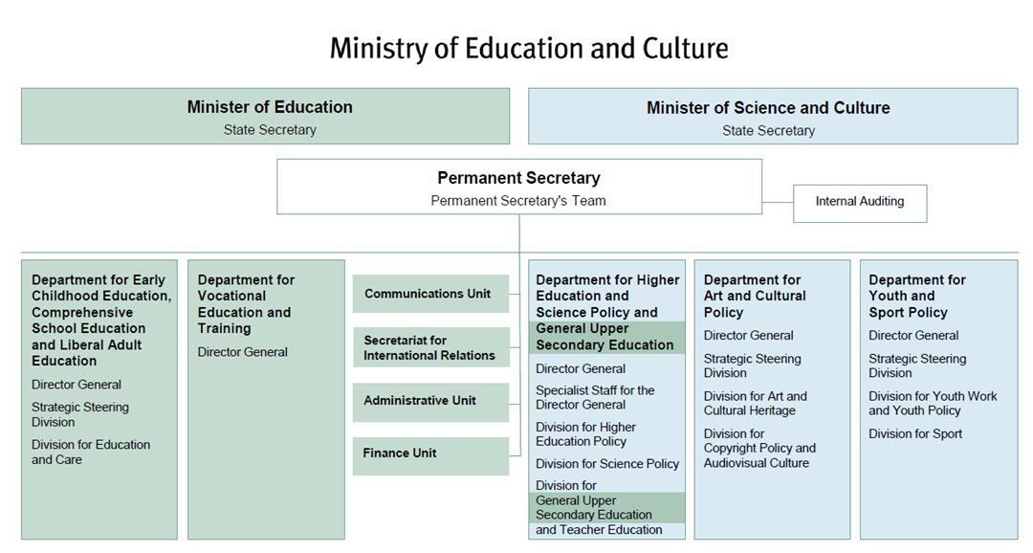

Slide 3
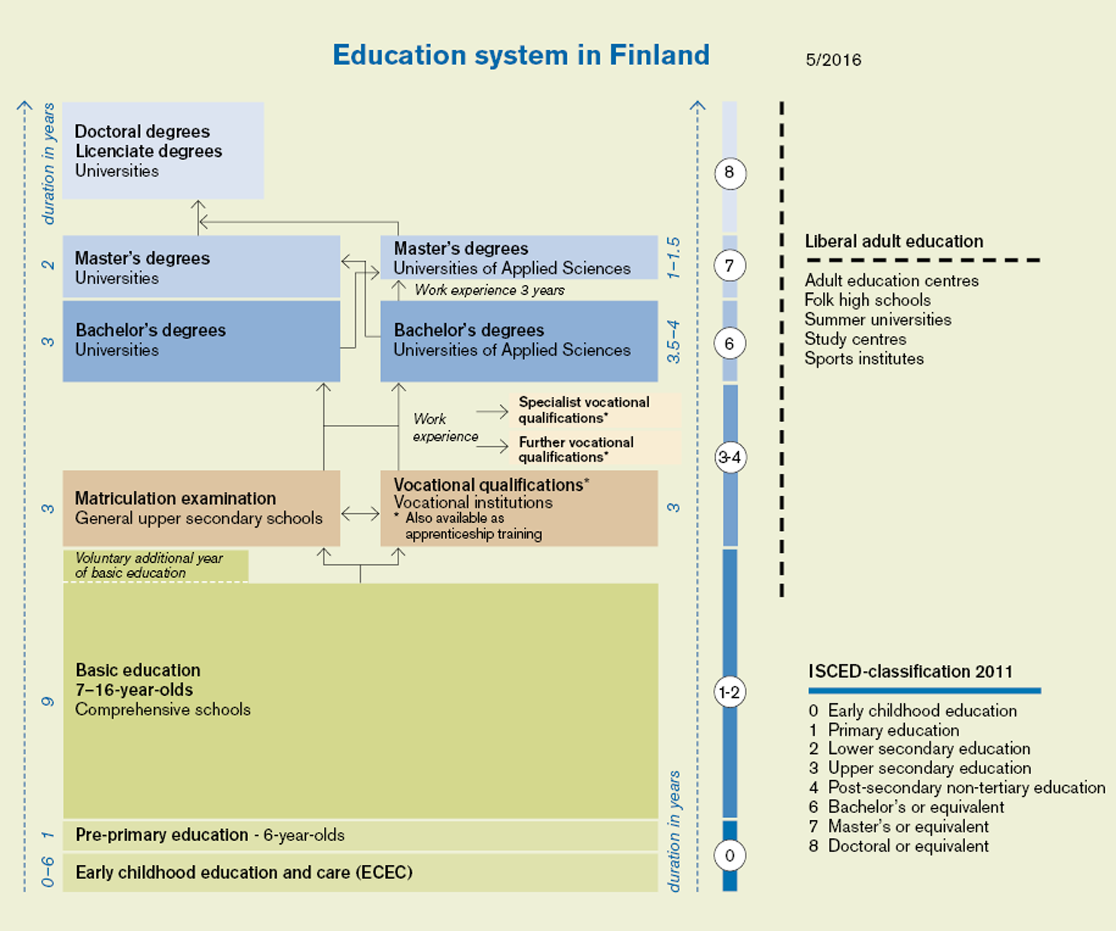
Flexible Education System

Slide 4
Administration of Basic and Upper Secondary Education in Finland
President of the Republic
Parliament
GOVERNMENT
Education Evaluation
Centre
Ministry of Education and
Culture
Other Ministries
National Agency
for Education
including
Center for International
Mobility, CIMO
Local Authorities and Joint Municipal Authorities
(Schools and other Educational Institutions)
Regional State
Administrative Agencies
Private Education Providers
(Schools and other Educational Institutions)
Matriculation
Examination
Board
State-maintained Educational
Institutions

Slide 5
CENTRAL FEATURES OF THE FINNISH EDUCATION SYSTEM
Equal opportunities for education irrespective of age, domicile, sex, economic situation or mother tongue
Pre-primary education compulsory and free of charge
Instruction free of charge, also meals, texbooks, health services and travel to and from school
Public authorities must secure equal opportunities for every resident in Finland to get education also after compulsory schooling and to develop themselves, irrespective of their financial standing.

Slide 6
CENTRAL FEATURES OF THE FINNISH EDUCATION SYSTEM
Decentralisation
about 317 municipalities
municipalities are given a lot of power
central guidelines and steering – local implementation
trust in the local authorities
Regional availability
Local authorities have a statutory duty to provide education for children of compulsory school age living in their areas, the prinicple of the "neighbourhood school"
the variation between the schools is small
Notes:
6

Slide 7
CENTRAL FEATURES OF THE FINNISH EDUCATION SYSTEM
All students have the same objectives and possibilities
Every student has a right to be supported in learning and in personal development and welfare
Individual support for learning and welfare of pupils – effort to minimise low achievement through early intervention
Co-operation between the school and the parents important
Notes:
7

Slide 8
CENTRAL FEATURES OF THE FINNISH EDUCATION SYSTEM
Development-oriented evaluation and pupil assessment
- no inspection system
- in basic education sample-based national testing of learning outcome, no ranking lists
- The Finnish Education Evaluation Centre and the National Board of Education are responsible for assessing learning learning outcomes
- national matriculation examination at the end of the upper secondary education, the only standardised test throughout the Finnish education system
Notes:
8

Slide 9
CENTRAL FEATURES OF THE FINNISH EDUCATION SYSTEM
Teachers are highly qualified experts
all teachers have Master’s Degree from university
the teaching profession is popular and has a high status
there is a lot of trust in the teachers
Active school leaders
wide participation in professional development
quite a lot of independence in the decision-making in school development
Notes:
9

Slide 10
ECEC (Early Childhood Education and Care)
Early Childhood Education Act improve the quality of early childhood education
Promotion of equality (§ 3) has been added to the objectives.
The priority of the child's interest in early childhood education is emphasized (§ 4).
Early childhood education needs to be organized close to service users (§ 5).
Multidisciplinary co-operation and development: an obligation to co-operate between early childhood education and care and social affairs (§ 7).
Protect the child from violence, bullying and other harassment (§ 10).
Hot meals should be arranged in a controlled manner for all children (§ 11).
A special educator in early childhood education is involved in assessing the needs for child when the child's early childhood education plan is drawn up (§ 23).
Round the clock day care is arranged when needed for the child because of the parent or other guardian's employment or study (§ 13).
Local government guidance and counseling are strengthened (§ 16).
The regulation on appeal has been clarified (Chapter 12, § 62).
Easier communication between early childhood education, the authorities and the home (§ 13).
The share of higher educated staff increases in kindergartens (§ 35), however, the multiprofessional staff structure will remain.
Minister of Education Ms. Li Andersson will quarantee subjective right to early childhood education for every children during this government period.

Slide 11
Basic Education
The new curriculum for pre-school and basic education
Finnish National Board of Education approved the new national core curriculum on December 22nd 2014. A local curriculum in accordance with the core curriculum was introduced for classes 1-6 in August 2016. The curriculum will be introduced to classes 7-9 in 2017, 2018 and 2019.
Children and young people are guided in assuming more responsibility for their own learning. Every student will be supported in his/her studies.
The pupils set goals, solve problems and assess their learning based on the objectives. The pupils' experiences, feelings, areas of interest and interaction with others lay the foundation for learning. The teacher’s role is to teach and activate pupils in lifelong learning. The pupils’ individual ways of learning will be acknowledged.
Engagement in learning will be supported
The goal is to develop the learning environment and working methods of the comprehensive school so that they inspire learning. In addition to the classroom, environments outside the school building are encouraged to be used for learning. This includes getting out into nature and visiting museums or businesses.
Games and other virtual environments are also part of the learning environment. Technology plays a significant role in everyday learning, and pupils can be even more involved in the development and selection of their own ways of learning. Transversial skills and competences are embedded in all subject learning, which give students a possibility to learn skills in addition to knowledge.
Opportunities for pupils to develop their information and communication technology skills as part of all subjects have been improved, with technology being included more in instruction and study.
Programming is included in the goals of mathematics. Pupils learn the fundamentals of programming even at the lower grades.

Slide 12
Transversal Skills and Competences in Core Curriculum (Primary and Lower Secondary Education, Finland)
Thinking and Learning to Learn (T1)
Cultural Competence, Interaction, and Self-Expression (T2)
Taking Care of Oneself and Managing Daily Life (T3)
Multiliteracy (T4)
Information and Communication Technology (ICT) Competence (T5)
Working Life Competence and Entrepreneurship (T6)
Participation, Involvement, and Building a Sustainable Future (T7)

Slide 13
The new Government Programme
Programme of Prime Minister Antti Rinne’s Government (6 June 2019):
INCLUSIVE AND COMPETENT FINLAND – a socially, economically and ecologically sustainable society
.
A Finland that promotes competence, education, culture and innovation

Slide 14
The new Government Programme Education
The level of education and competence among the population will rise at all levels of education, differences in learning outcomes will decrease, and educational equality will increase
Children and young people will feel well
Education and training will enhance gender equality and nondiscrimination in society
Finland will be an internationally attractive place to study, conduct research and invest

Slide 15
The level of education and competence among the population will rise at all levels of education, differences in learning outcomes will decrease, and educational equality will increase
By the end of 2020, the Government will provide a report on education policy
The government will carry out a comprehensive review of the special features, challenges and development needs of education provided in Swedish
Securing equal opportunities for pursuing individual learning pathways.
Examining the effectiveness of the legislation on special needs teaching,

Slide 16
Cont.
Particular attention to the growing inequality recognised within and between schools, in larger towns, between regions, in learning outcomes between genders, and among first and second-generation immigrant children and young people.
A specific programme that will ensure the learning conditions for first and second-generation children and young people and secure their transition to the next level of education.
During this government period government will raise the minimum school leaving age to 18 years.
Advocating the learning of basic skills during the early years by reconfiguring preprimary education and the first two years of primary school into a more coherent system
As part of this approach, we will examine the possibility of providing pre-primary education over a two-year period.
Parliamentary reform of continuous learning

Slide 17
Children and young people will feel well
Promoting low-threshold support services for children, young people and families,
Student welfare services at all levels of education so that all children and young people receive the support they need.
Strengthen the study guidance provided at different levels of education.
Guarantee every child and young people a genuine opportunity to pursue a leisure activity of their choice as part of the school day.

Slide 18
Education and training will enhance gender equality and nondiscrimination in society
Action plan to improve the quality and equality of early childhood education and care
The subjective right to full-time early childhood education and care, and we will reduce the group sizes for over 3-year-olds (1/7 ratio).
Quality criteria for early childhood education and care.
A study on how the right to early childhood education and care is realised for paperless children and children seeking asylum.
We will ensure the right of every young person, person who has had to discontinue their studies before arriving in Finland and paperless person to complete their comprehensive school education.

